Slide 1
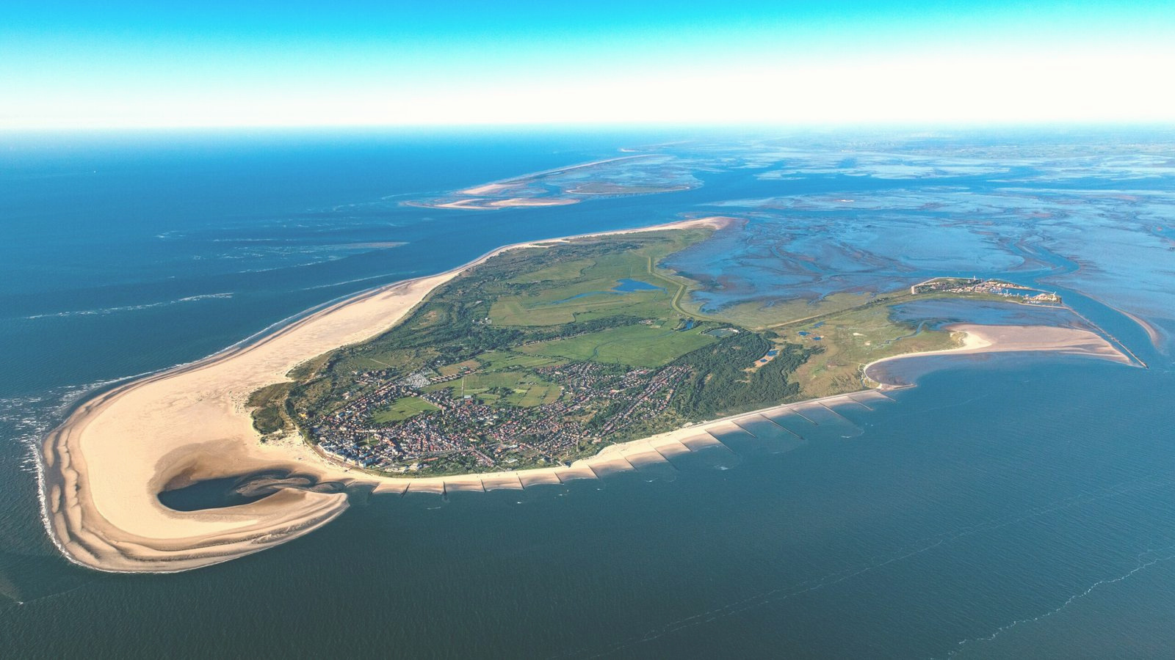

Welcome to Borkum

Slide 2


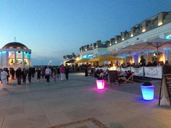

BORKUM
Borkum is the largest of the East Frisian Islands in the North Sea, part of Lower Saxony, Germany. It's situated in the Wadden Sea, a UNESCO World Heritage site famous for biodiversity and tidal flats.

Slide 3



Facts about Borkum
Exploring Borkum
Presentation Focus
Data Analysis
Introduce island paradise with stunning visuals and compelling information.
Highlight the beauty and attractions of Borkum island.
Data Analysis and Visualization

Slide 4
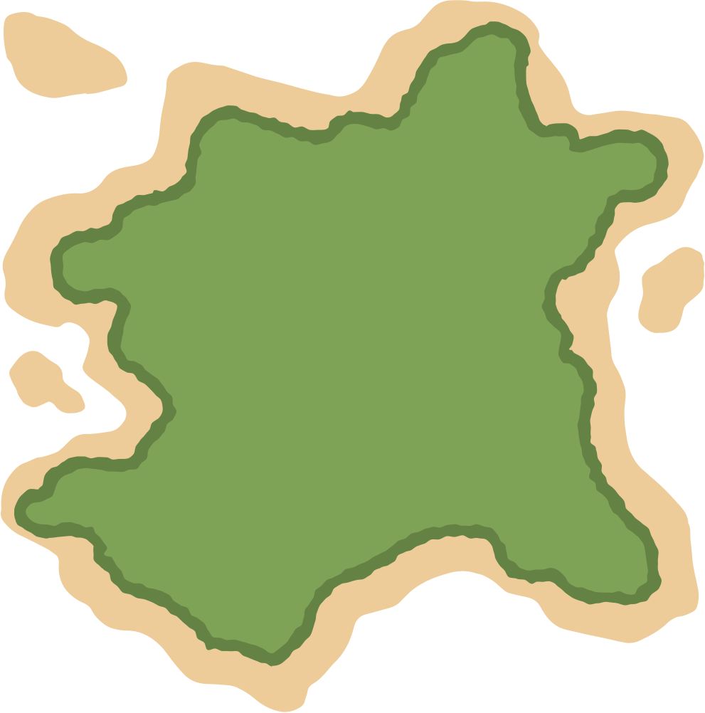

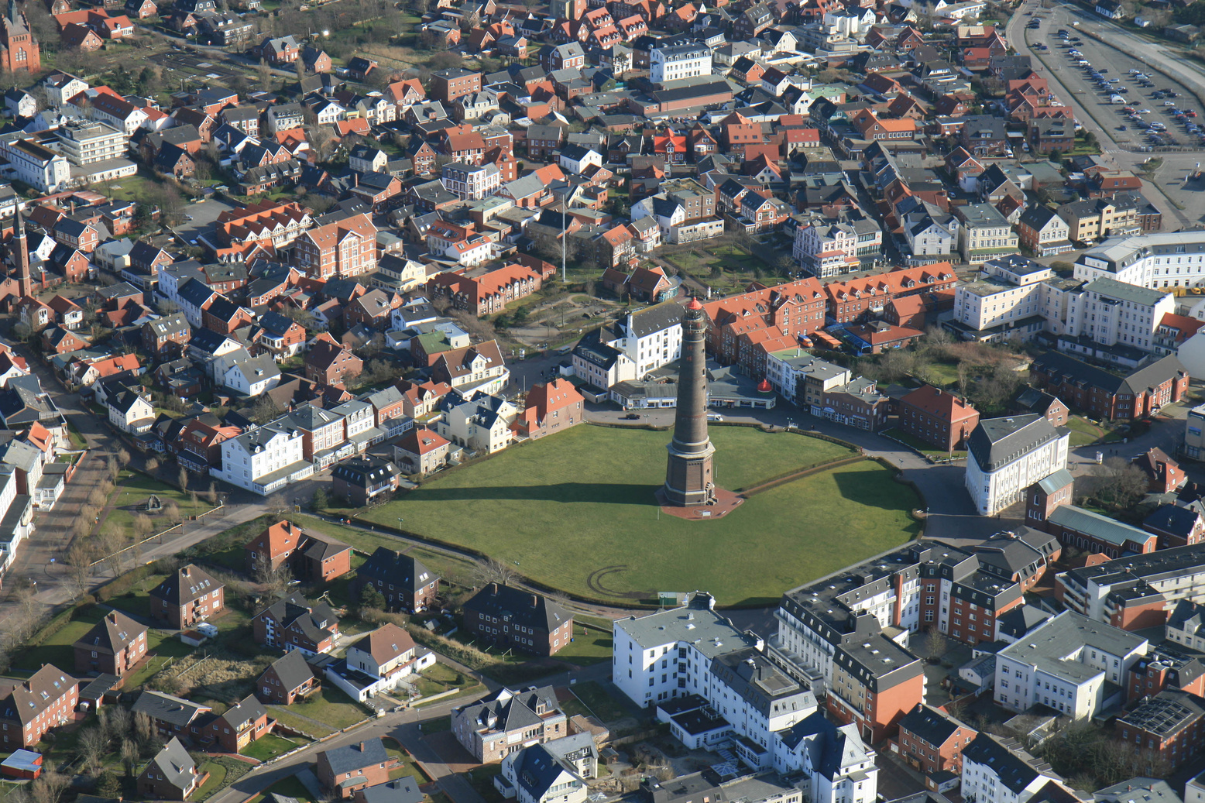

History of Borkum
Borkum Island, with a history dating back to Roman times known for beans, was part of a larger island chain until the 18th century. It thrived on whaling but faced poverty and emigration after the industry declined. Today, Borkum is a tourist destination famous for its natural beauty and maritime heritage.

Slide 5

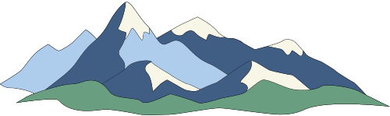




WHY BORKUM?
Borkum is perfect for relaxation, outdoor fun, and cultural experiences.
Texel Island boasts natural beauty with stunning beaches, dunes, and a UNESCO site, the Wadden Sea.
It is recognized for health benefits like clean air and thalassotherapy.
The island offers various outdoor activities such as cycling, hiking, bird watching, and water sports.
Texel is rich in wildlife, housing seals and diverse bird species.

Slide 6
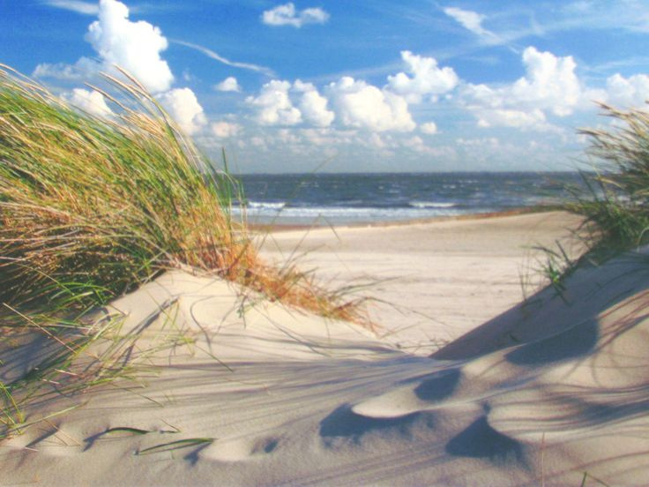
Cont...
Cultural Attractions: Historical sites, museums, and festivals.
Accessibility: Reachable by ferry.
Family-Friendly: Offers activities for children.
Gastronomy: Fresh seafood and local cuisine.
Sustainability: Emphasis on eco-tourism and conservation.

Slide 7

Infographic

Slide 8
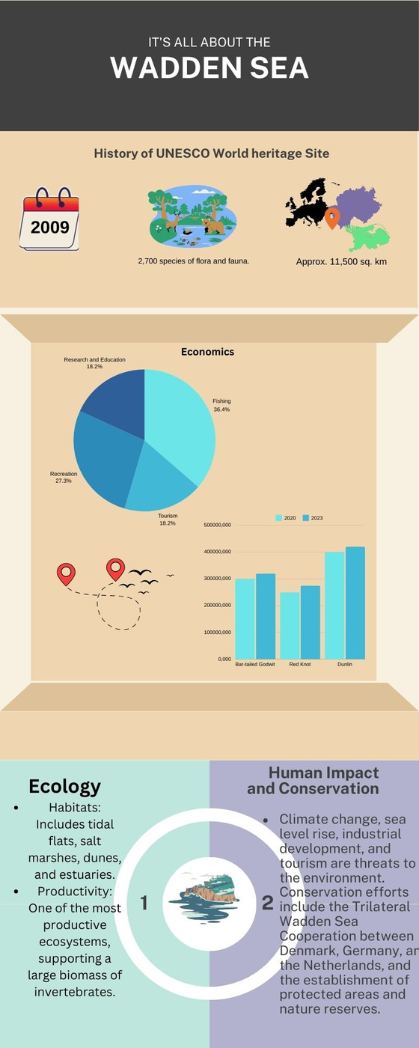
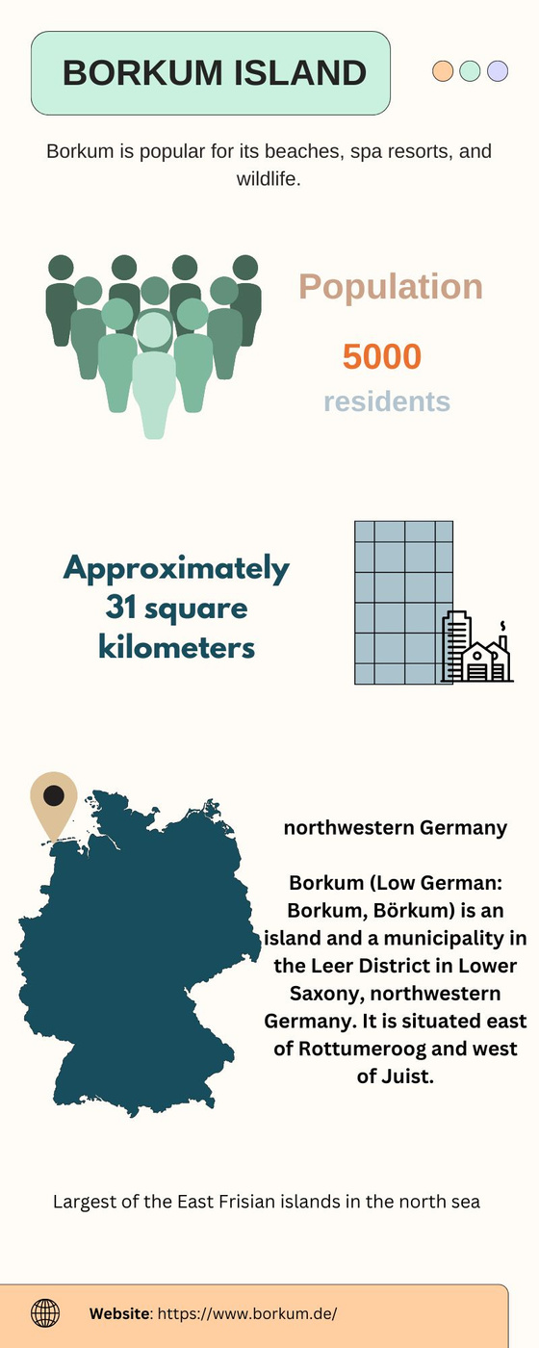

Slide 9
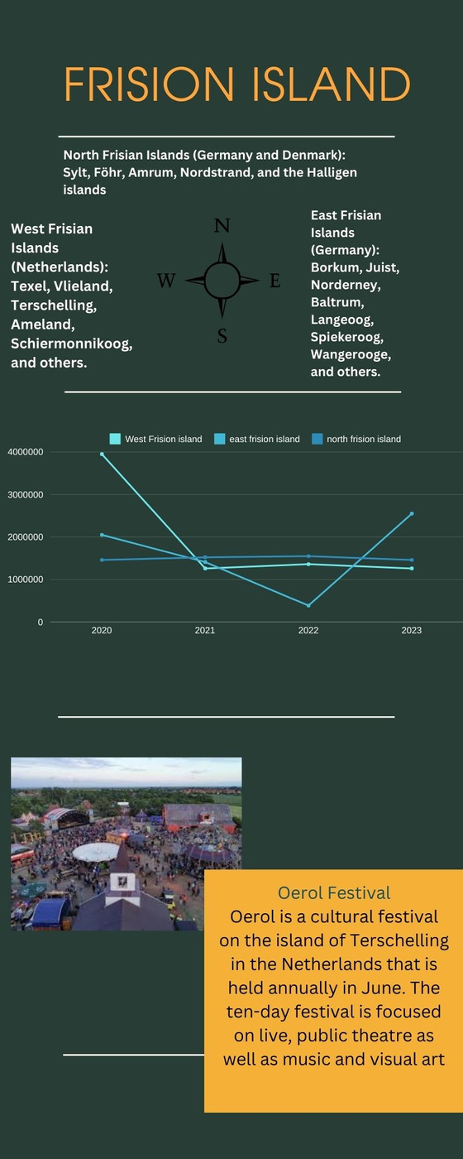
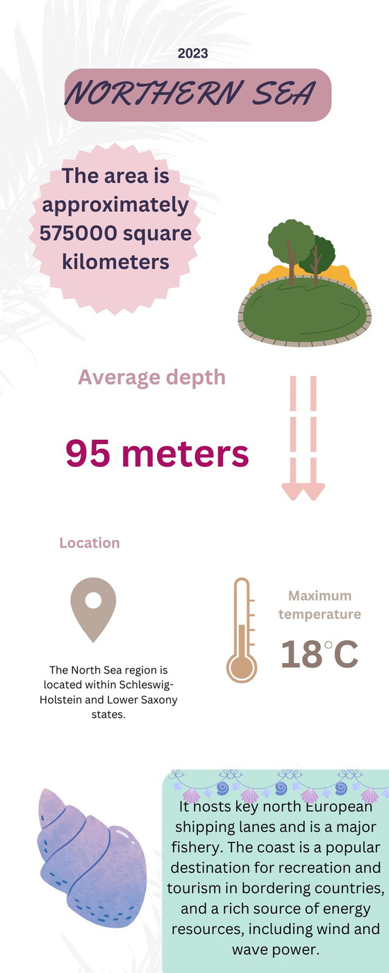

Slide 10


Data Analysis

Slide 11
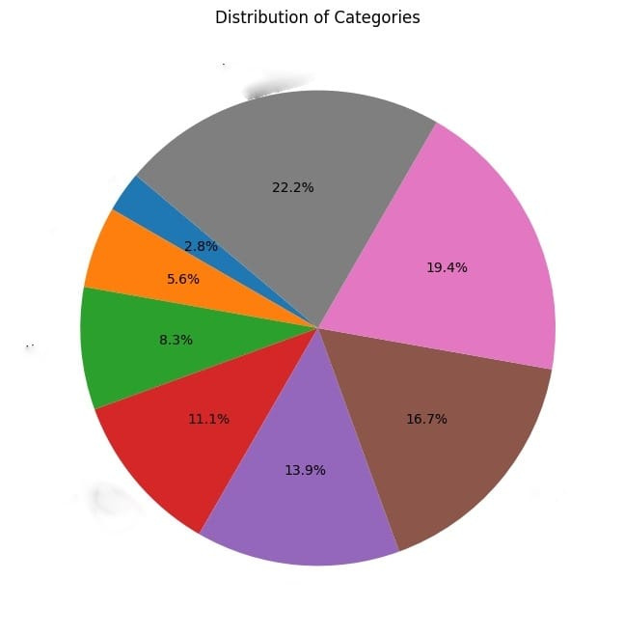
Why is Borkum important to you?
1 ) Tourist = 22.2%
2)2nd home / vacation home = 11.1%
3) patient = 19.4%
4)Family on island= 5.6%
5) work= 8.3%
6)Living on island= 16.7%
7)Others= 2.8%
8)Interest on island = 13.9%

Slide 12
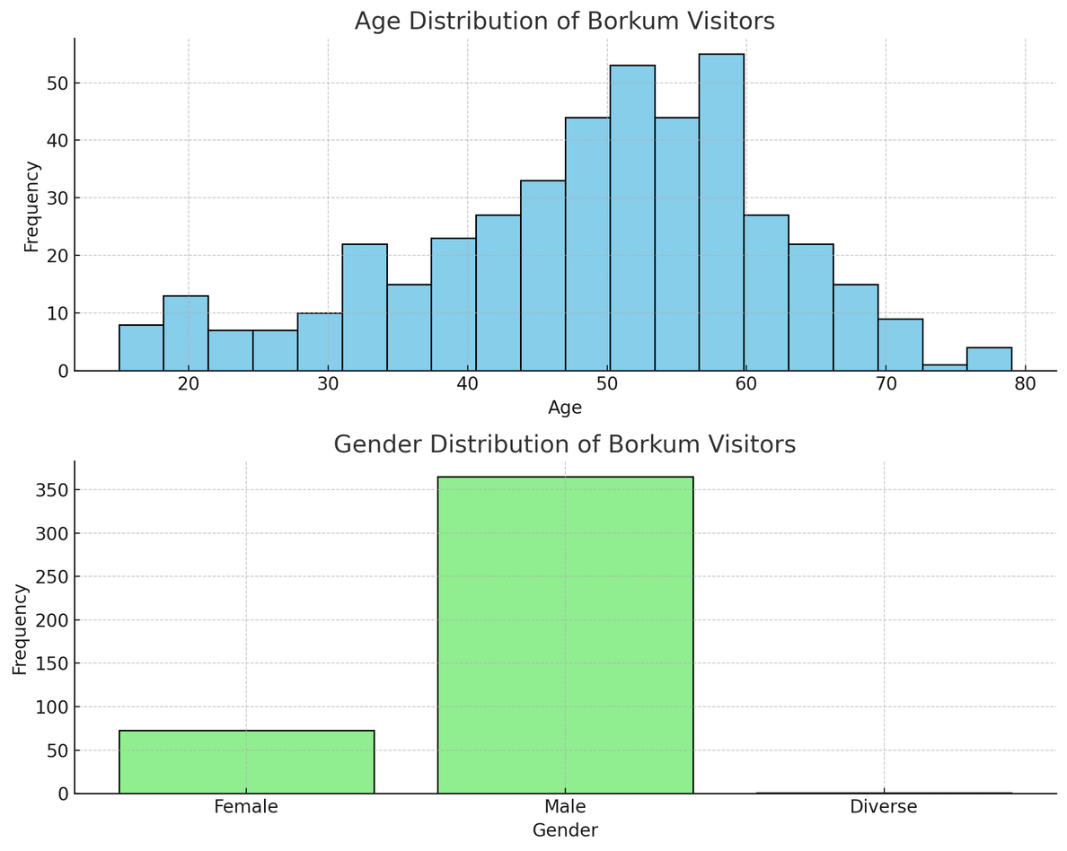
Age and Gender distribution of Borkum Visitors
General Insights
Broad Appeal: Borkum attracts a wide audience across ages and genders.
Targeted Marketing Opportunities: Knowledge of the demographic majority helps in designing effective marketing.
Inclusivity: Presence of diverse gender visitors indicates inclusivity, beneficial for marketing and service improvements.
Male
Female
Gender

Slide 13
Age Distribution Insights:
Diverse Demographics: Visitors span a wide range of ages.
Clusters: Noticeable clusters in the 20-30, 40-50, and 60-70 age ranges.
Potential Peaks: Indicates popular times for family vacations, retreats, and retirement trips.
Gender Distribution Insights:
There is a higher number of female visitors compared to male and diverse gender visitors, possibly due to marketing, travel preferences, or women's travel groups. A small representation of diverse gender visitors reflects inclusivity and diversity among travelers.

Slide 14
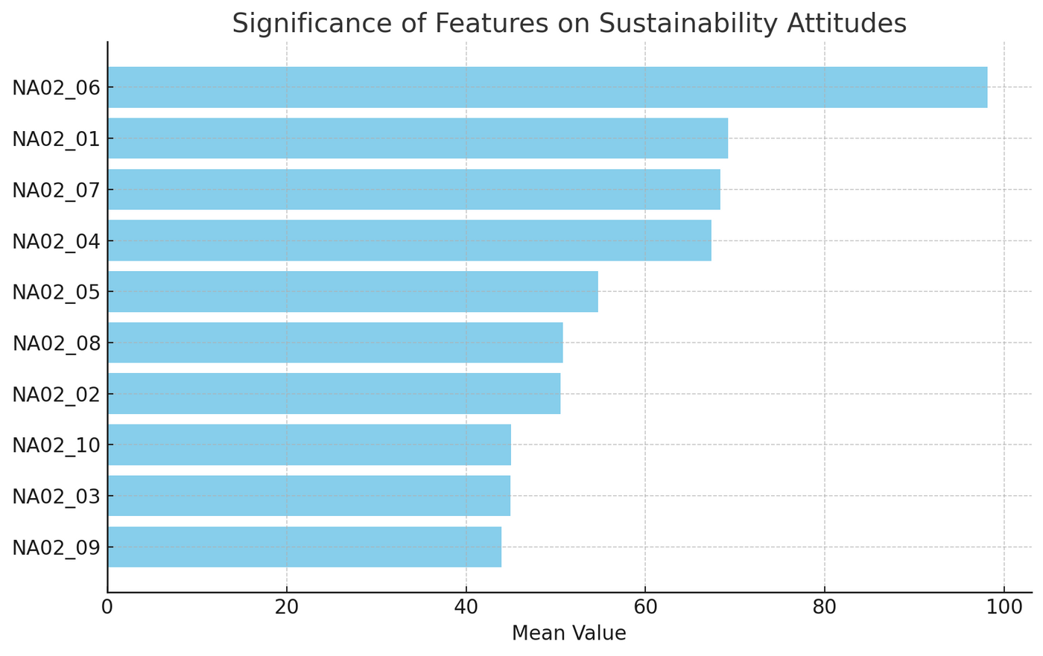
The graph shows factors affecting sustainability attitudes on Borkum island.
NA02_06 I let no trash lying around
NA02_01 No reason to be sloppy
NA02_07 I actively collect trash on island
NA02_04 I use my own coffe-to-go cups or recap
NA02_05 I choose take out food only without plastic
NA02_08 I tell othersnot to walk on protected area
NA02_02 Green transportation is important
NA02_10 Restaurants have to have substainable products
NA02_03 I shop only substainable clothing
Na02_09 Substainable accomodation is most important

Slide 15
High importance on waste management, avoiding plastic waste, and cleanliness in eco-friendly travel. Visitors prioritize eco-friendly transportation and lodging, with personal sustainable practices valued moderately. This guides policymakers and tourism operators in focusing on sustainability initiatives.

Slide 16
Thank You
For joining our Borkum Island adventure. See you soon!
Aimee Saintete Iyizerwa
Anagha Biju Cheriyan

